Slide 1
《Image processing visualization system》
Project Management Report

Slide 2
contents
01 Project Plan Overview
02 Project execution detail
03 Risk Plan
04 Product demo
05 Test plan and case
06 Summary and Reflection

Slide 3
1 Project Plan Overview
Our project aims to develop a visualization software for image processing techniques, providing a simple and intuitive platform for beginners who are interested in learning about image processing and deep learning. The software is designed to simplify the complex concepts and algorithms associated with image processing and deep learning. It will offer a range of intuitive and interactive features that allow beginners to visually observe the effects of these techniques.

Slide 4
2 Project execution detail
Group 1
Visual interface image processing
Group 2
License plate detection
Testing

Slide 5
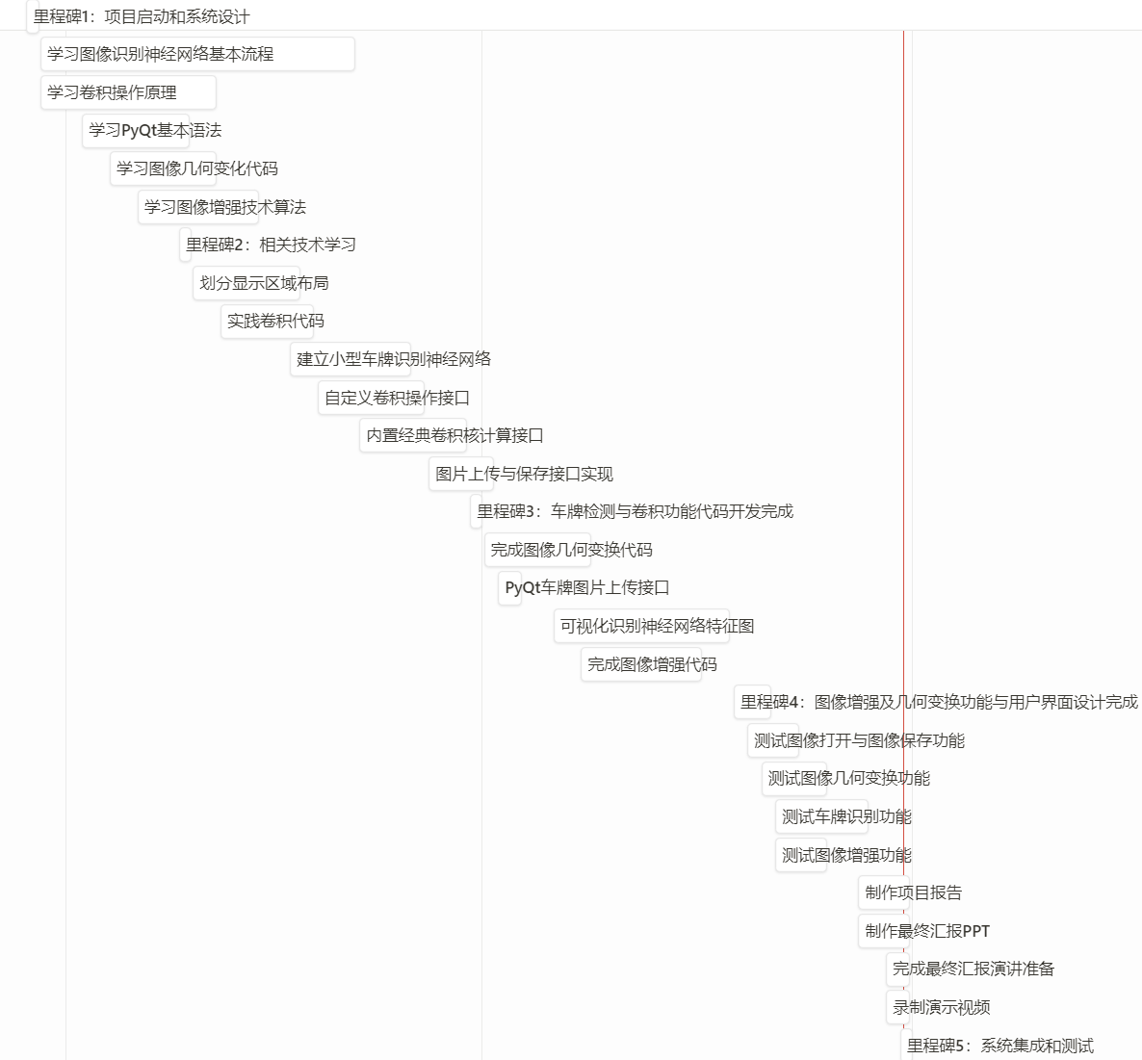
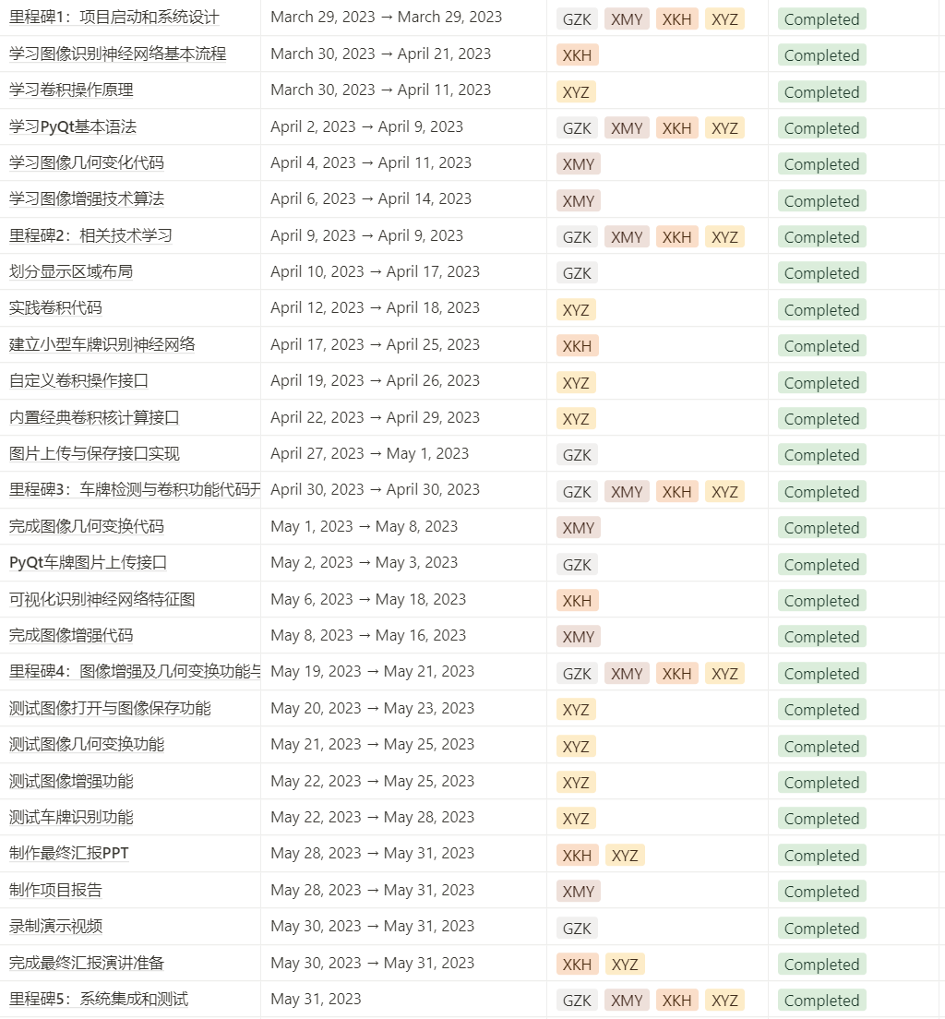
2 Project execution detail

Slide 6
2 Project execution detail
milestone | program completion date | actual completion date | whether in time
Project initiation and system design | 2023.3.29 | 2023.3.29 | √
Related technical learning | 2023.4.9 | 2023.4.8 | √
Core code development | 2023.4.30 | 2023.5.11 | ×
UI interface and other functions | 2023.5.21 | 2023.5.21 | √
Integration and testing | 2023.5.31 | 2023.5.31 | √

Slide 7
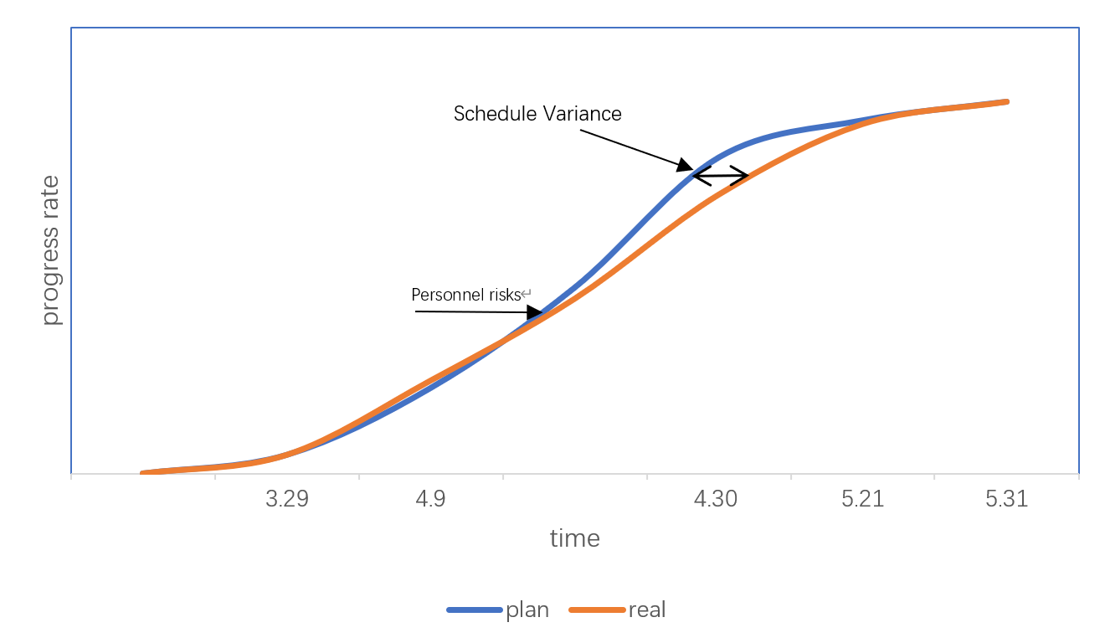
2 Project execution detail

Slide 8
3 Risk plan
 | Possible causes | negative impact | seriousness
Technical risks | Complex technology | Re-select technology | C
Personnel risks | Influenza Personal affairs Personnel conflict | Feature development paused Affect working atmosphere and efficiency | A
Requirement risks | Frequent Requirements Changes Requirement misunderstanding Unclear Requirement | Cause technical risk Imperfect function | B
Other risks | vacation | project suspended | D

Slide 9
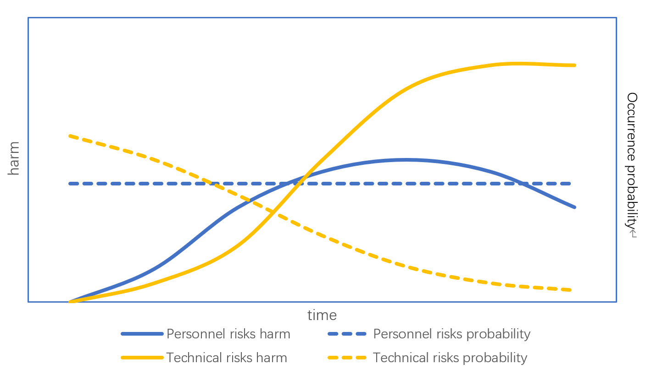
3 Risk plan

Slide 10
3 Risk plan
Response strategies
Technical risks：We need to have team discussions and conduct technical validations to assess the feasibility and time cost of the new approach.
Personnel risks：Transfer the functionality to another team member as a replacement and consider simplifying the features to ensure the smooth development of core functionality.
Requirement risks： The team needs to collectively assess the necessity and feasibility of the changes to ensure that the required modifications do not impact the overall project timeline.
Other risks： Discussion and reevaluation of the development plan and risk assessment are required.
Risk reviews will be conducted every three weeks to assess project progress, summarize lessons learned, and incorporate them into process improvements.

Slide 11
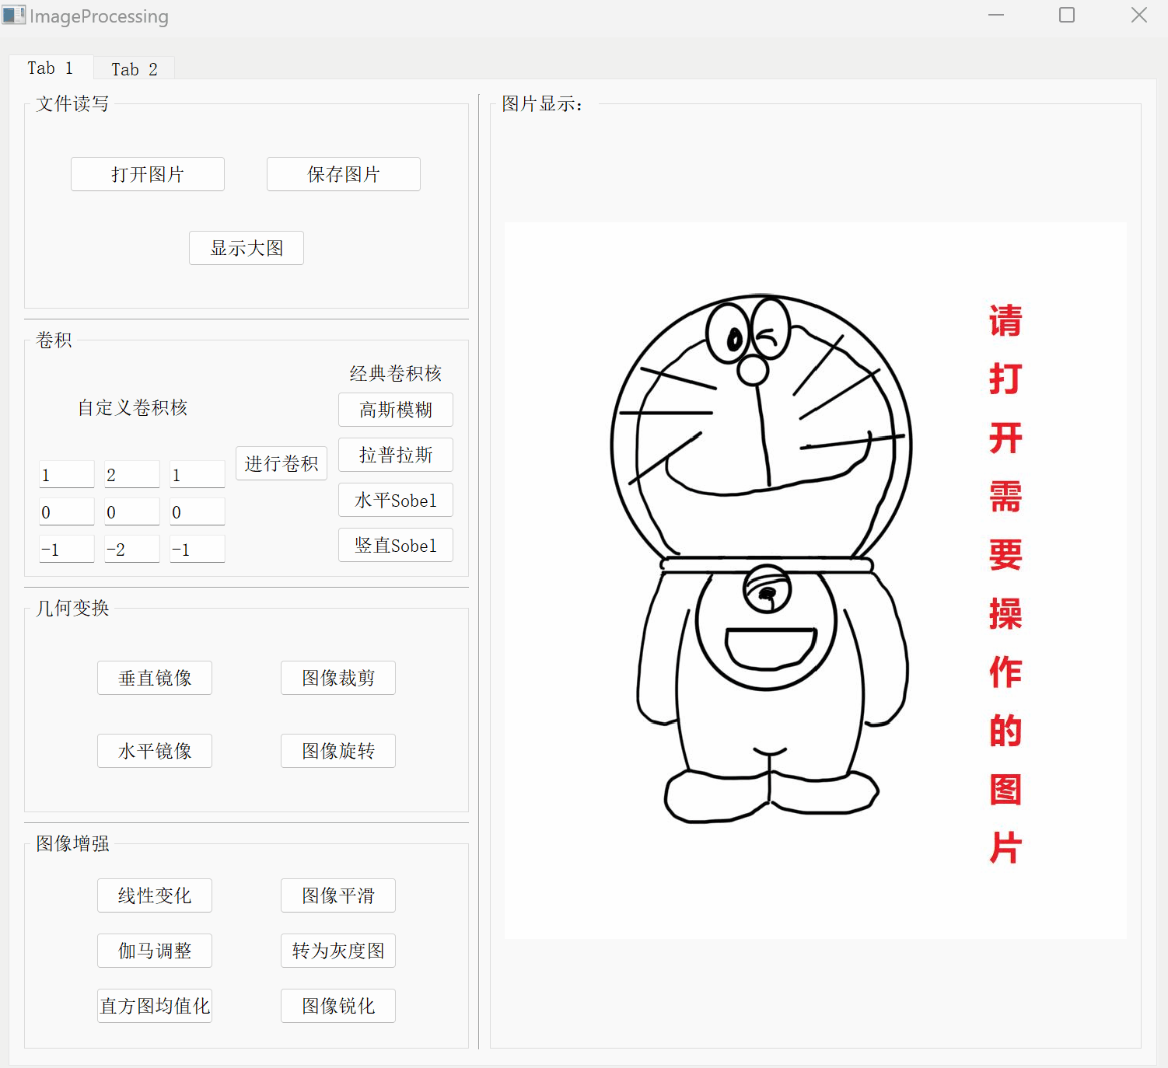
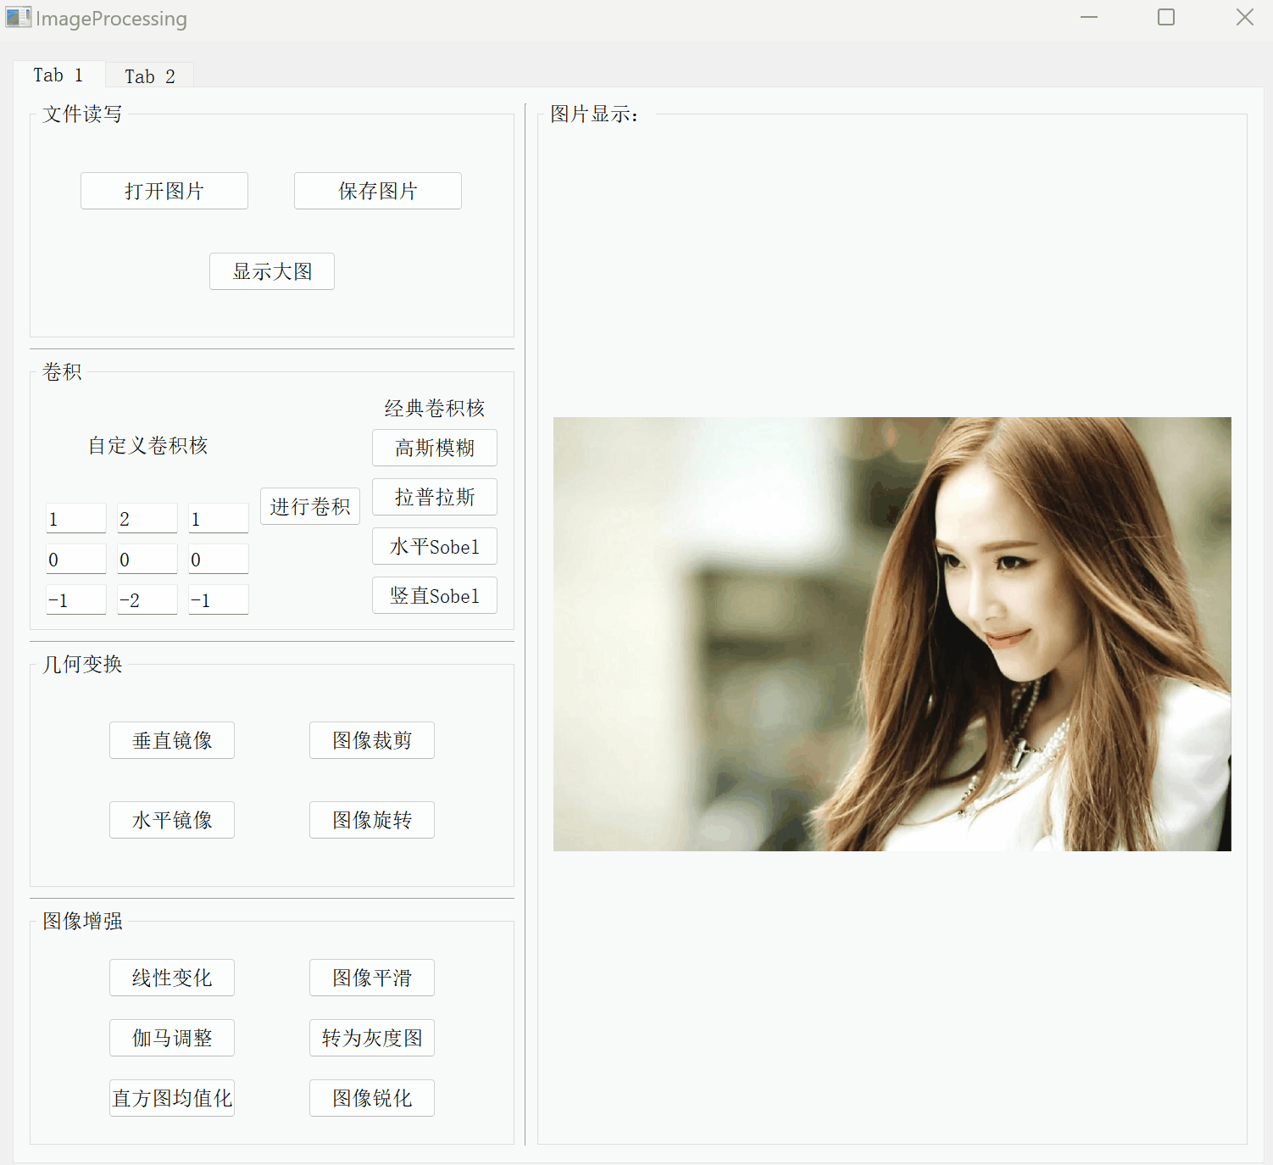
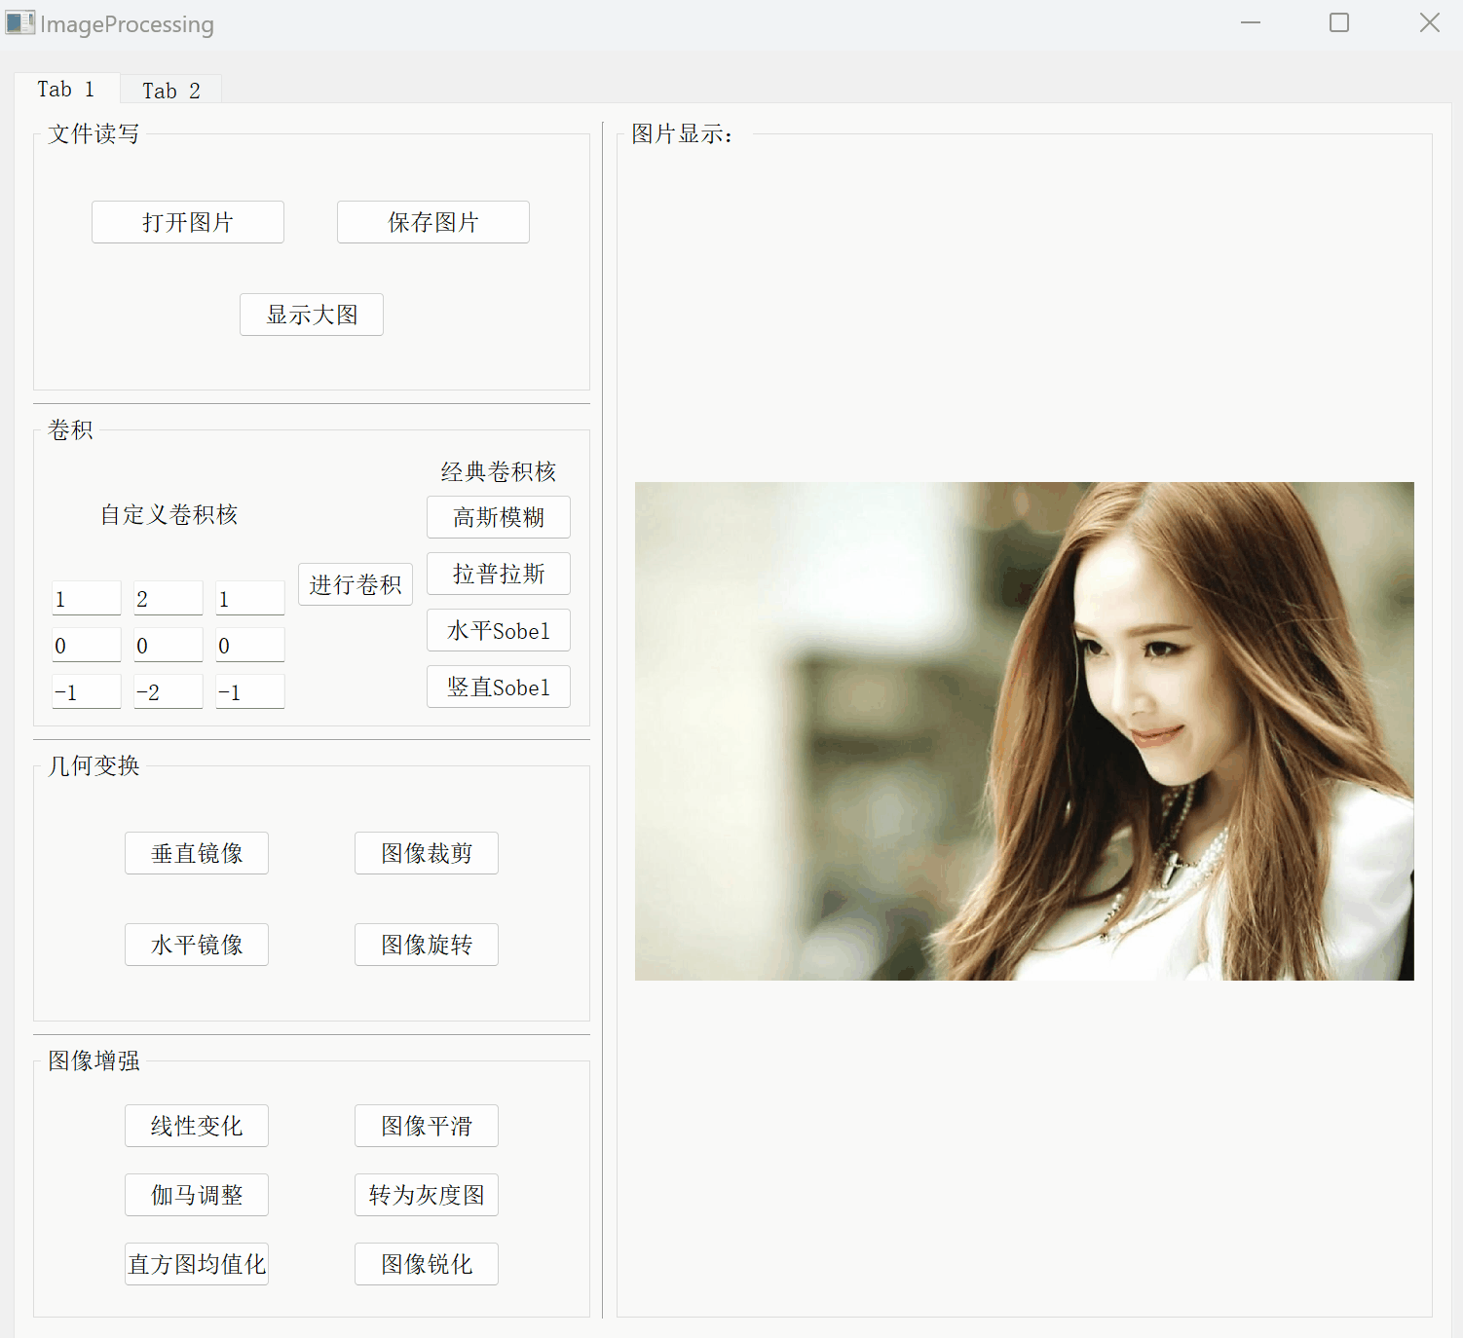

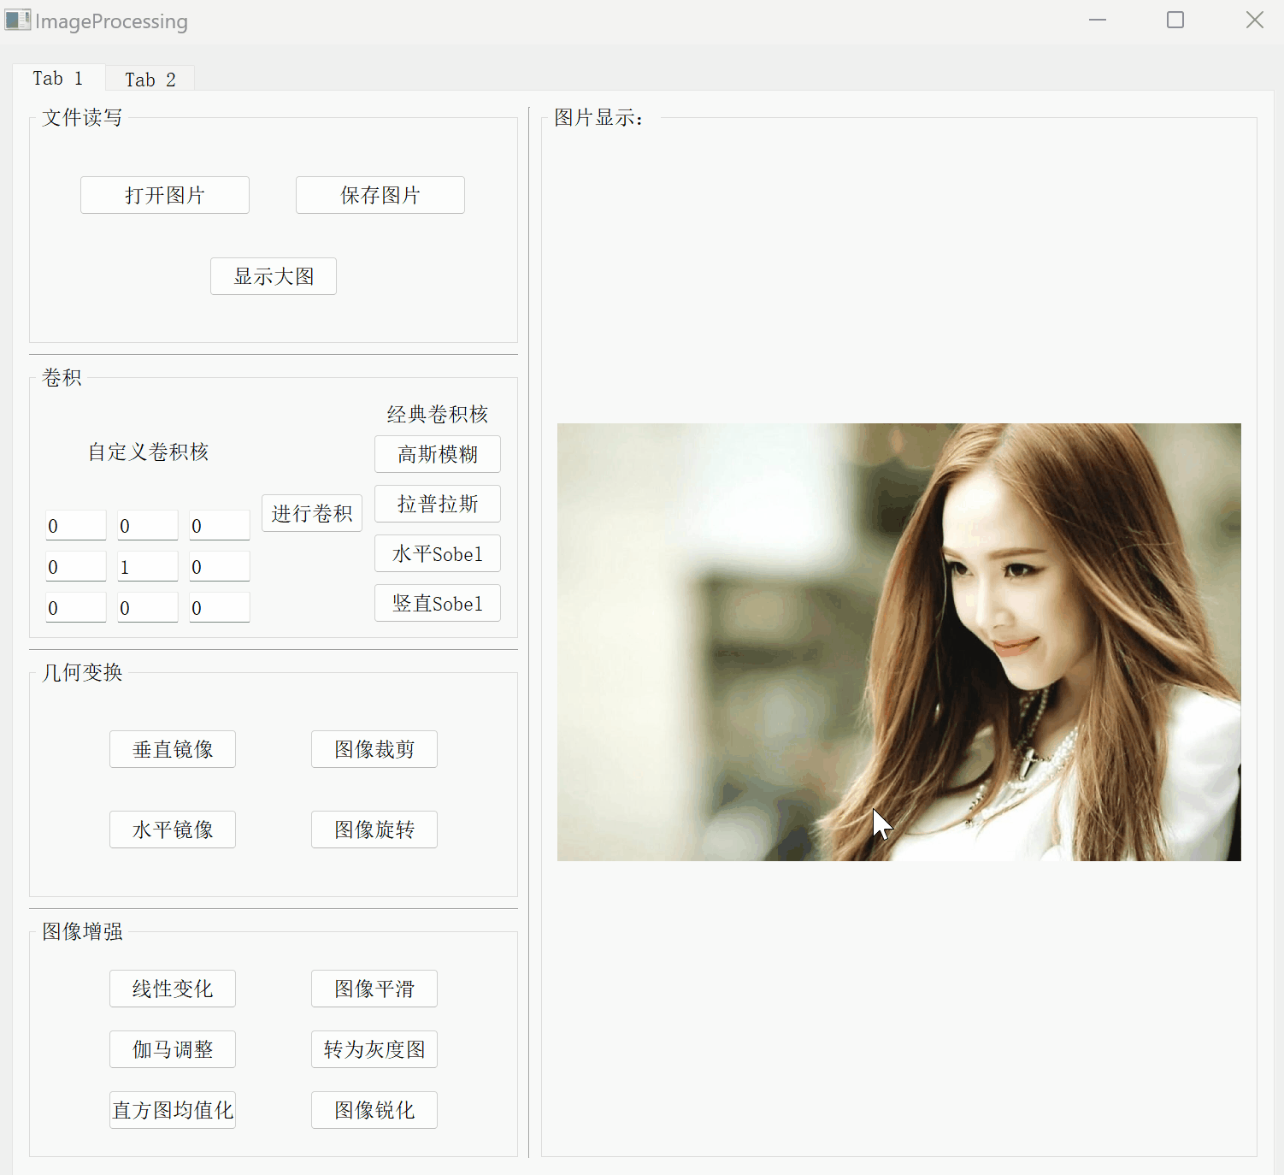

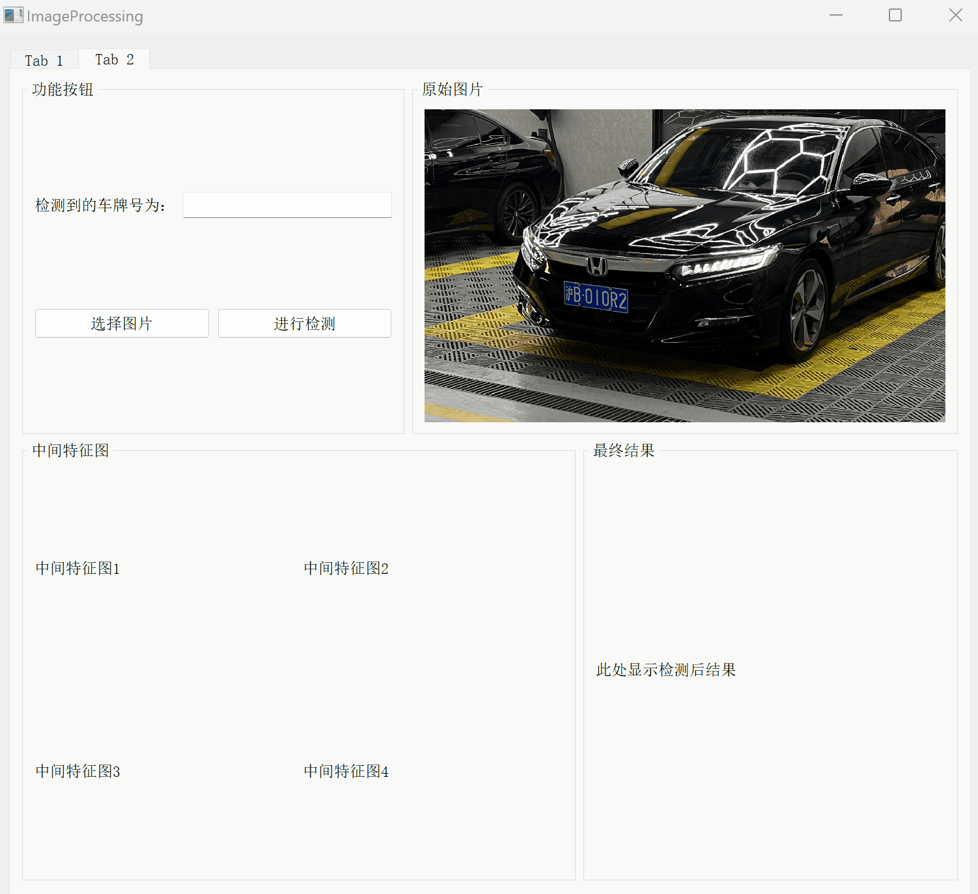
4 Product demo

Slide 12
5 Test plan and case
test | The purpose and importance of project software testing are to ensure high quality and reliability of the software before it is delivered to end users.
Test specification | The GUI involved in the project and all the functions
Purpose and expected result | Ensure that all images are displayed correctly in their respective GUI, guaranteeing that all functions correctly process the images. For critical functions, it is also important to ensure completion within the specified timeframe.
The strategy of testing | Unit test
Test tools | Unittest、Qtest、XTestRunner
Tester | Xu Yuzhuo
Test time | Two weeks

Slide 13
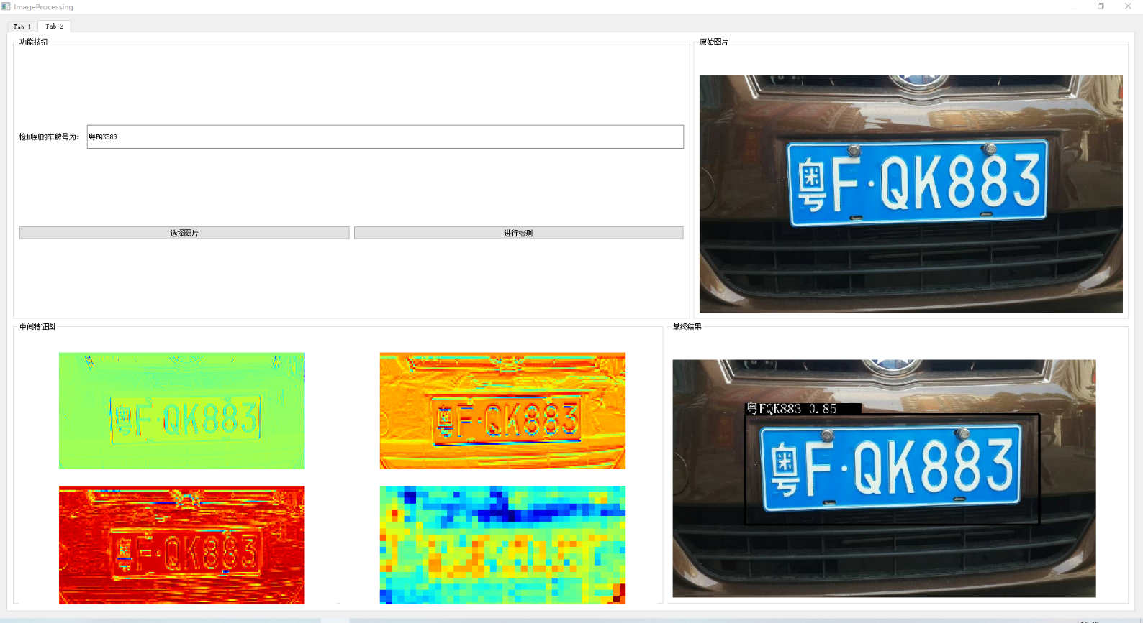
5 Test plan and case
Main function : License plate recognition and middle diagram, result diagram display
Purpose :
1) This function can correctly identify the license plate number of different types of pictures.
2) The middle picture and the final result picture can be correctly displayed.
3) The identification time is within 1.1s.
4) When the user does not select the picture, will the prompt dialog box pop up

Slide 14
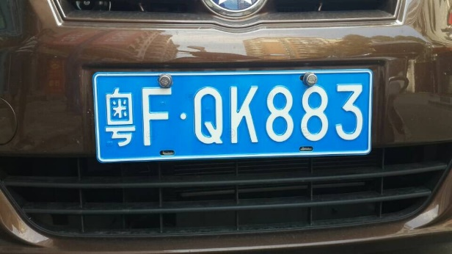
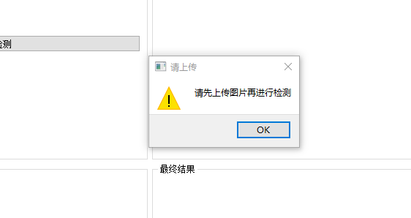





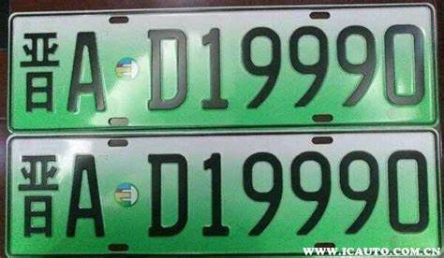
5 Test plan and case
Cases :

Slide 15
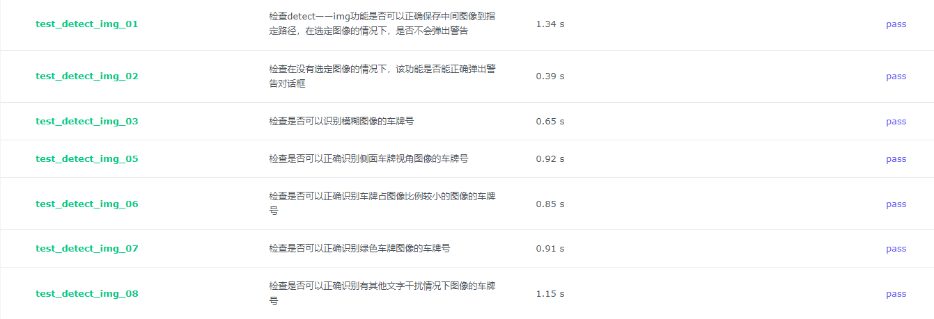
5 Test plan and case
Result :

Slide 16
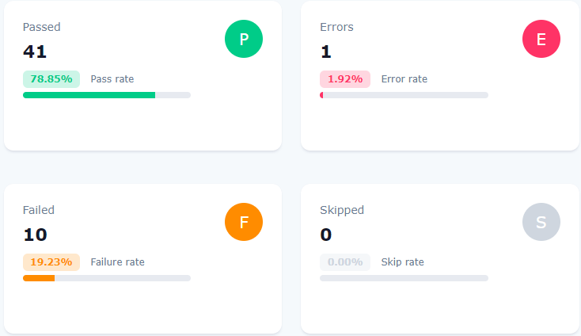
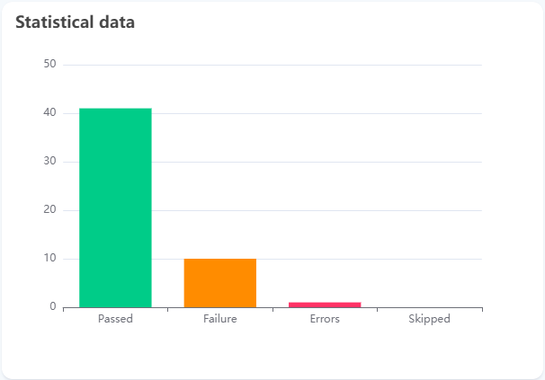
5 Test plan and case
Total Result :

Slide 17
6 Summary and Reflection
Reflection：The project only considered certain risks while neglecting others, as the project's mindset remained limited to the school environment. Personnel risks were limited to short-term issues like sick leave, neglecting long-term risks such as severe illnesses. This lack of consideration had a significant impact on the project's progress. The chosen group development approach only partially mitigated unexpected events, ultimately affecting the development timeline. Overall, the risk planning aspect was unsuccessful.
Conclusion：Through this project management practice, we learned the experience of unsuccessful risk management has highlighted its significance and the importance of exceptional team management. We realized the need for a methodical and meticulous development process, considering every detail. Project management is a comprehensive discipline， not just a matter of technical development.. In this iteration, we successfully completed key functionalities, and in future iterations, we will address critical bugs and enhance functionality details. Finally, heartfelt thanks to all team members for their dedicated efforts.

